Slide 1
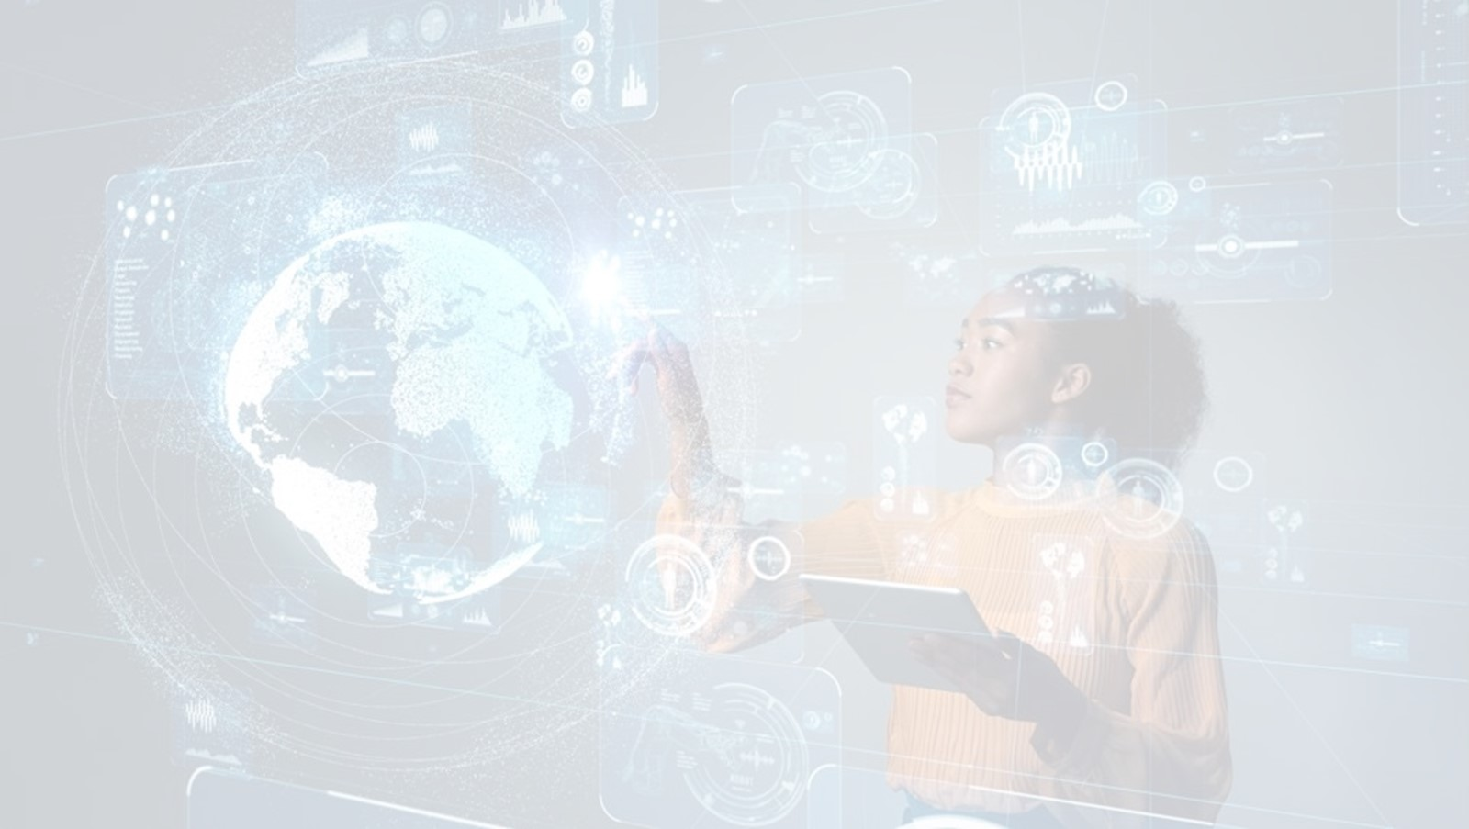
QUANTUM COMPUTER
- A new era of future computing
Prepared by: abc

Slide 2

Index
Generations of computer.
Introduction about quantum technology.
Applications of quantum technology.
Quantum computer
What is quantum computing?
Why quantum computer?
History
What is qubits?
How quantum computers work?
Applications
Advantages and disadvantages.

Slide 3
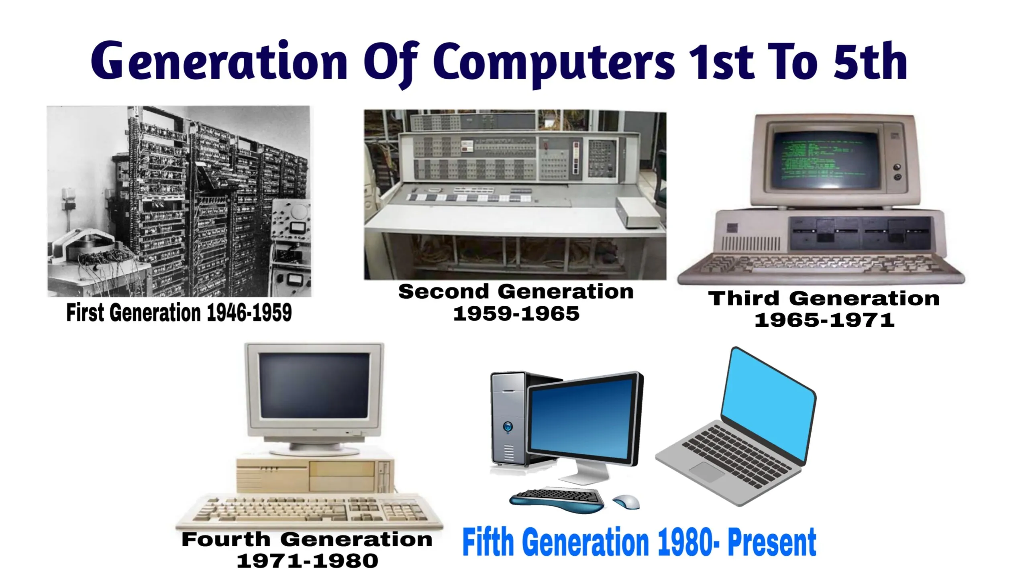
Generations of computer
First generation computers (1940-1956)
vacuum tubes
Second generation computers (1956-1963)
Transistors
Third generation computers (1964-1971)
Integrated Circuits

Slide 4
Generations of computer
Fourth generation computers (1971-present)
Micro-processors
Fifth generation computers (present-beyond)
Artificial Intelligence (AI)
Sixth generation computers (future)
Quantum computers

Slide 5
Introduction of quantum technology
Quantum technology is a technology that works by using the principles of quantum mechanics.
The two principles of quantum mechanics that quantum technology primarily relies on are quantum superposition and quantum entanglement.
Quantum superposition: is a physics theory that subatomic particles can exist in multiple states at once.
Quantum entanglement: occurs when two atoms joined or fixed together despite being separated by space.
The field of quantum technology was first outlined in a 1997 book by Gerard J. Milburn, which was then followed by a 2003 article by Jonathan P. Dowling.

Slide 6
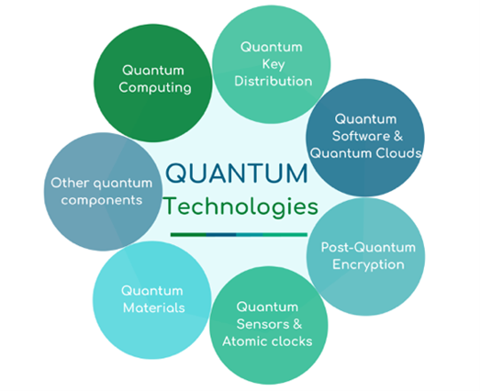
Applications of quantum technology
Quantum computing
Quantum sensors
Quantum communication
Quantum simulation
Quantum cryptography

Slide 7
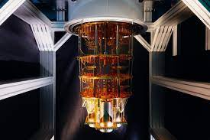
Quantum computer ??
A quantum computer is a computation device that makes direct use of quantum-mechanical phenomena, such as superposition and entanglement, to perform operations on data.

Slide 8
What is quantum computing ?
Quantum computing is the computer technology based on the principles of quantum theory, which explains the nature and behavior of energy and matter on the quantum(atomic or subatomic) level.
A quantum computer is a computation device that makes direct use of quantum-mechanical phenomena, such as superposition and entanglement, to perform operations on data.
Quantum computing is essentially harnessing and exploiting the amazing laws of quantum mechanics to process information.

Slide 9
Why quantum computer ?
Quantum AI systems will be able to process large amounts of information quickly and accurately.
Because quantum computers can perform several tasks at the same time, which allows for significantly faster results.
For some problems, supercomputers aren’t that super.
To solve complex problems, that supercomputer can’t able to solve.

Slide 10
History:
Year | scientist | Research
1982 | Richard Feynman | Idea of creating machines based on the laws of quantum mechanics.
1985 | David Deutsch | Developed the quantum turning machine, showing that quantum circuits are universal.
1994 | Peter Shor | A quantum algorithm to factor very large numbers in polynomial time(n^2).
1997 | Lov Grover | Develops a quantum search algorithm with 0 complexity. The first tiny quantum computer was built.
2000 | Emanuel Knill, Raymond Laflamme, and Rudy Martinez | Successfully built both a 4-qubit and a 7-qubit quantum computer

Slide 11
What is qubits ?
In quantum computing, a qubit is a unit of quantum information.
It represents the smallest possible unit of computation in quantum computing.
It exists in both of its possible states at once, a condition known as a superposition.
Qubit is known as quantum bit and the heart of quantum computer.
It is made up of photons, atoms, electrons, molecules or something else.

Slide 12
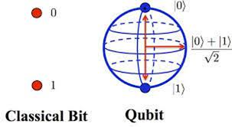
Bit | Qubit
It’s a single unit of information that has a value of either 0 or 1 | It can hold a one, a zero or a combination of these.
Bits are used in classical computers. | Qubits(Quantum bits) are use in quantum computer
Bits are slow. | Qubits are faster.
Information is stored in bits, which take the discrete values 0 and 1. | A qubit can be in states labelled (0 and 1), but it can also be in a superposition of these states, a|0} + b|1}, where a and b are complex numbers.

Slide 13

How quantum computer works?
A quantum computer uses qubits to run multidimensional quantum algorithms.
Our quantum processors need to be very cold – about a hundredth of a degree above absolute zero. To achieve this, we use super-cooled superfluid to create superconductors.
When electrons pass through superconductors they match up, forming "Cooper pairs." These pairs can carry a charge across insulators, through a process known as quantum tunneling.
Two superconductors placed on either side of an insulator form a Josephson junction

Slide 14
Superposition is the ability of a quantum system to be in multiple states at the same time.
Superposition allows quantum objects to simultaneously(occurring at the same time) exist in more than one state or location.
Entanglement is when two particles link together in a certain way no matter how far apart they are in space. Their state remains the same.

Slide 15
If the qubit is in a superposition of the 1 state and the 0 state, and it performed an calculation with another qubit in the same superposition, then one calculation actually obtains 4 results: 1/1, 1/0, 0/1 and 0/0.
The ability of a quantum computer to perform multiple computations simultaneously(parallel) is called quantum parallelism.
If there are n qubits in the quantum computer, then it will have 2^n different states.
So experimentally, it can hold more information as compare to regular bits.

Slide 16
Benefits and limitations:
Advantages | Disadvantages
Quantum computing required less power. | Quantum CPU will have efficiency and heating problems of its own.
It can execute any task very faster and very accurately compared to a classical computer. | Current quantum computers are largely prototypes that are still bulky(large and heavy), complicated and expensive .
Quantum computers are incredibly fast and effective. | To developed quantum computer became so costly.
Quantum computers are able to analyze the data to provide feedback much more efficiently than traditional computers. | As the processing in these computers is done very deeply so it needs a temperature of negative 460 degrees F. This is the lowest temperature of the universe and it is very difficult to maintain that temperature.

Slide 17
Applications:
Quantum computing with the help of machine learning can help in developing various techniques to fight against these cybersecurity threats.
It can be used to solve complex mathematical problems.
Modelling and indexing of very large databases.
Quantum computer can be used in cryptography (quantum key distribution).

Slide 18

Contribution of Indian government
The government in its budget 2020 has announced a National Mission on Quantum Technologies & Applications with a total budget outlay of Rs 8000 Crore for a period of five years to be implemented by the Department of Science & Technology (DST).
Created 21 Quantum hubs in the country.
4 Quantum research parks across India.

Slide 19

Present status
Nowadays many companies/countries are trying to make quantum computers.
IBM hopes to have a 1,000-qubit quantum computer in place by 2023.
Google has been working on building a quantum computer for years and has spent billions of dollars. It expects to have its quantum computer ready by 2029.
Public and private investments totaled $35.5 billion by 2022 across a range of quantum technologies.’

Slide 20
Thank you

